Slide 1
Bishop Gore School
Working together to tackle deprivation and raise standards

Slide 2
Our location

Slide 3
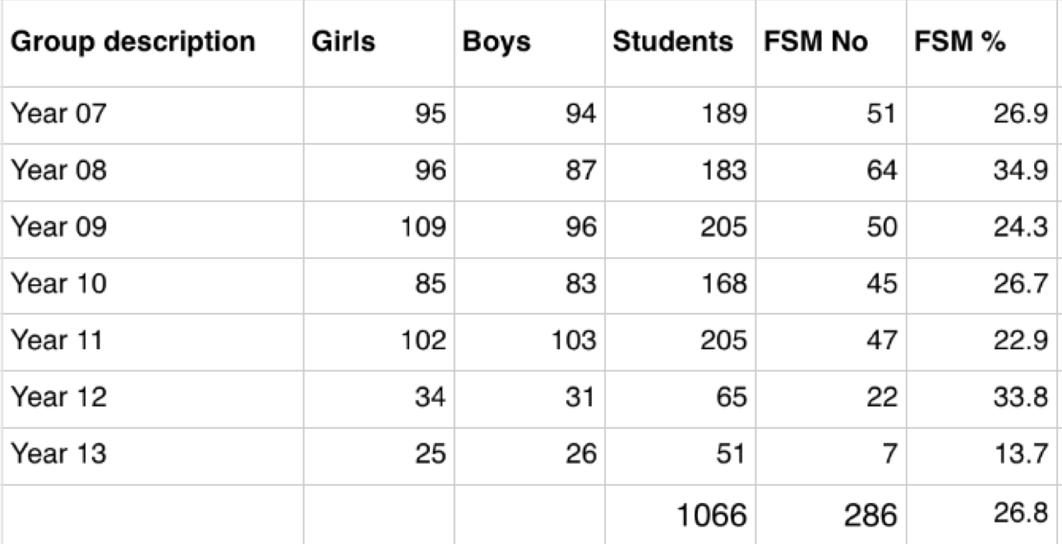
Our context - FSM

Slide 4
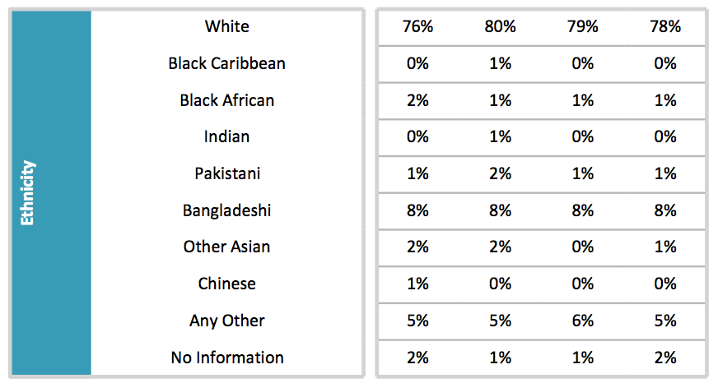
Our context - Ethnicity

Slide 5
Our context – SEN and Mobility

Slide 6
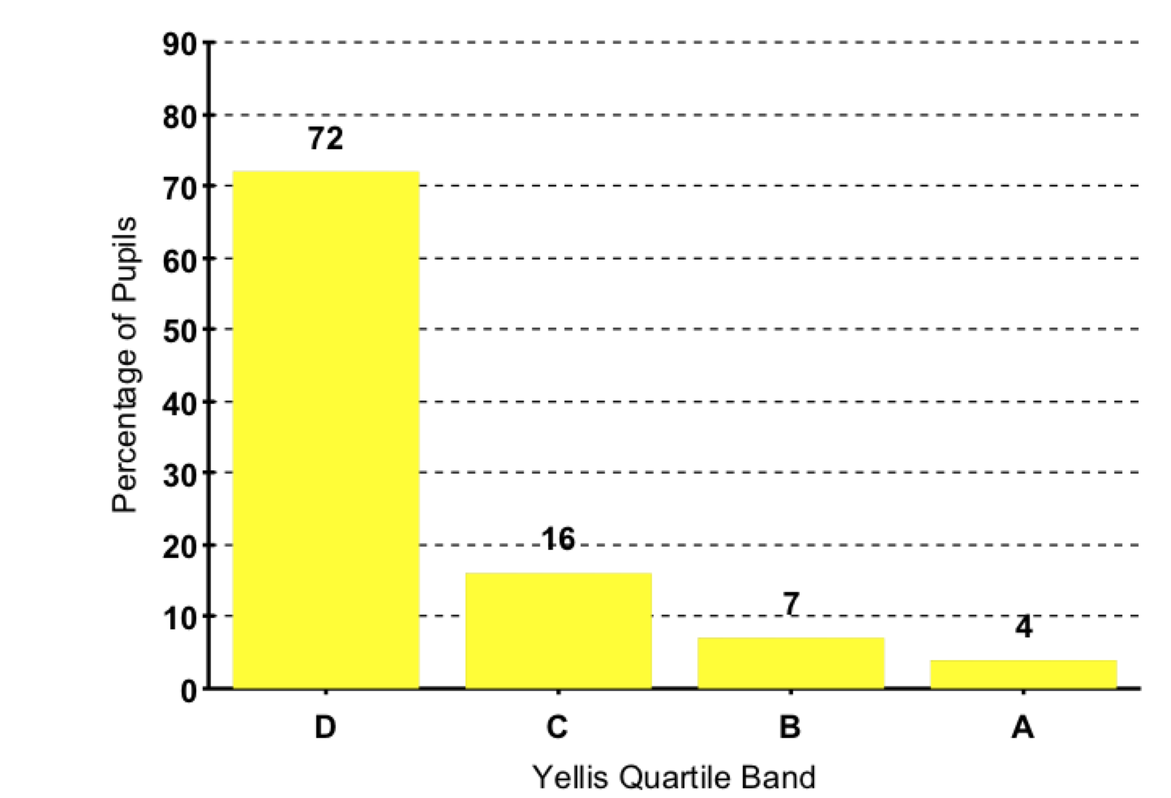
Our context – ability profile (y11 2013)

Slide 7
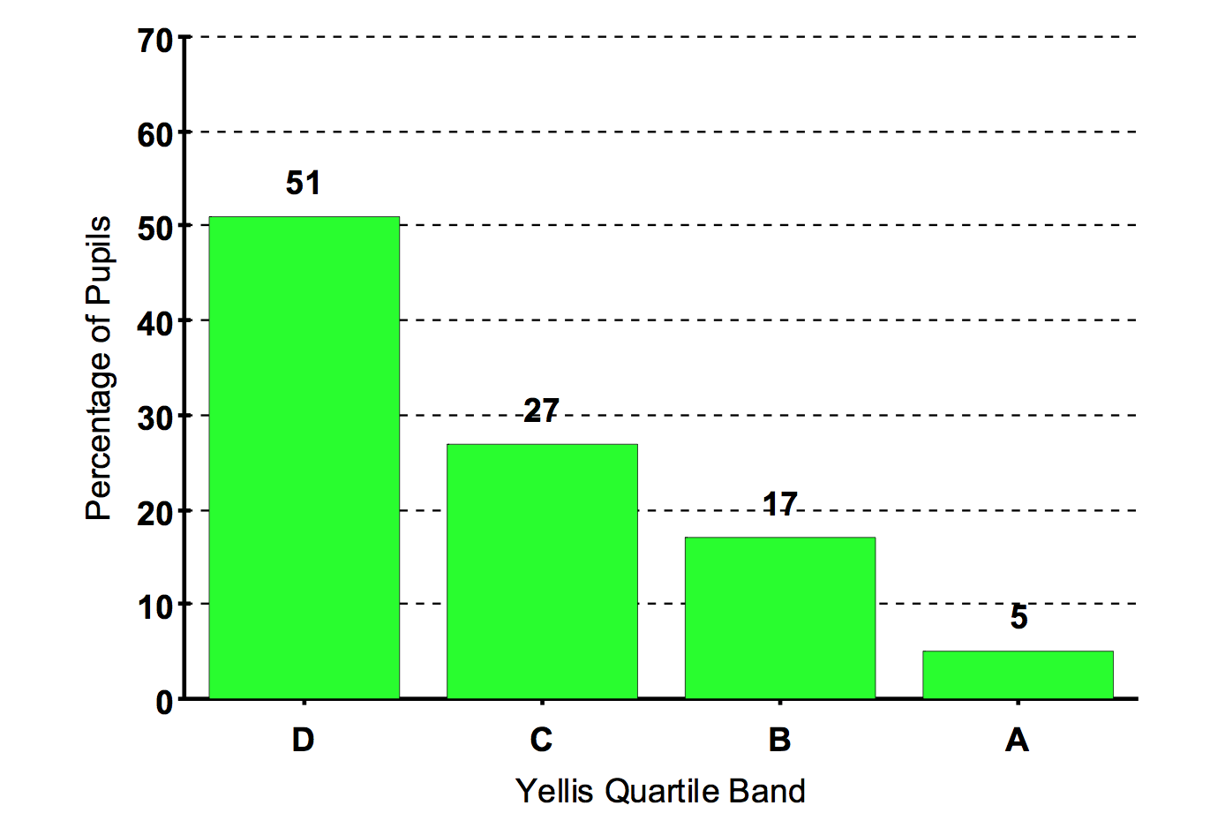
Our context – ability profile (y11 2014)

Slide 8
Tackling deprivation – a strategic approach – why?
The relationship between deprivation and education is crucial for understanding the significant impact deprivation has on later outcomes in adulthood. There is a very clear pathway from childhood poverty to reduced employment opportunities, with earnings estimated to be reduced by between 15 and 28% and the probability of being in employment at age 34 reduced by between 4 and 7% (Blanden, Hansen & Machin, 2008).

Slide 9
Tackling deprivation - targets
The global grade is the grade we expect the learner to aim for in all subjects, which ensures that our expectations in relation to standards of learning and teaching remain high. Whilst it is true to say that learners have strengths and weaknesses in different subjects, the global grade provides a good indication of what can be achieved, with the appropriate commitment, effort, challenge and support.
It is our firm belief that each and every learner should be given the opportunity to reach his/her potential and that expectations of all learners should remain high. Identifying potential by means, principally, of objective, predictive tests ensures that opportunities for all are equal.
Bishop Gore Assessment Policy

Slide 10
Tackling deprivation - curriculum

Slide 11
Tackling Deprivation - Curriculum

Slide 12
Tackling Deprivation - Curriculum

Slide 13
Tackling deprivation – parent/carer partnerships
Surgeries
Review Days

Slide 14
Tackling deprivation – Working with community groups
Ethnic Youth Support Team
Supports BME pupils and families
Bridge between school and home
High achievement culture mirrors our aspirations

Slide 15
Our performance

Slide 16
Our performance

Slide 17
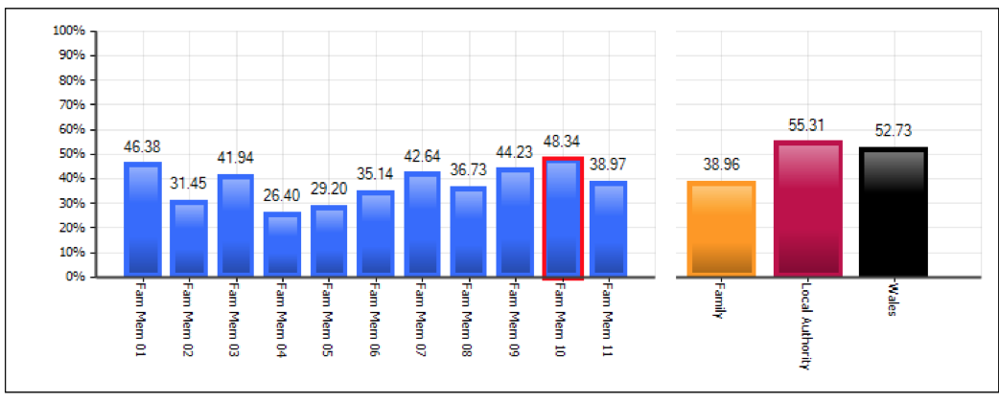
Our performance

Slide 18
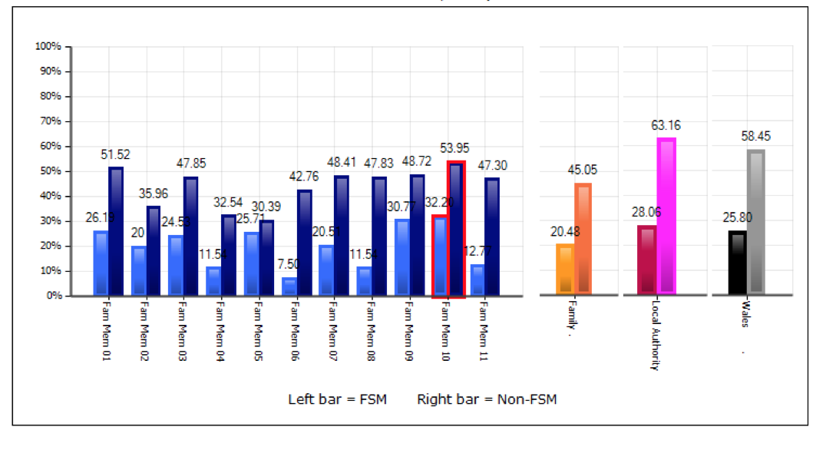
Our performance

